Slide 1

Home
Notes:
image
No alt text provided

Slide 2


Slide 3
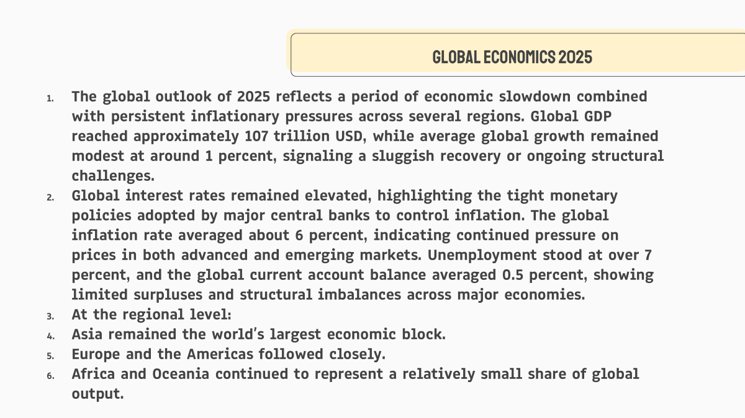

Slide 4
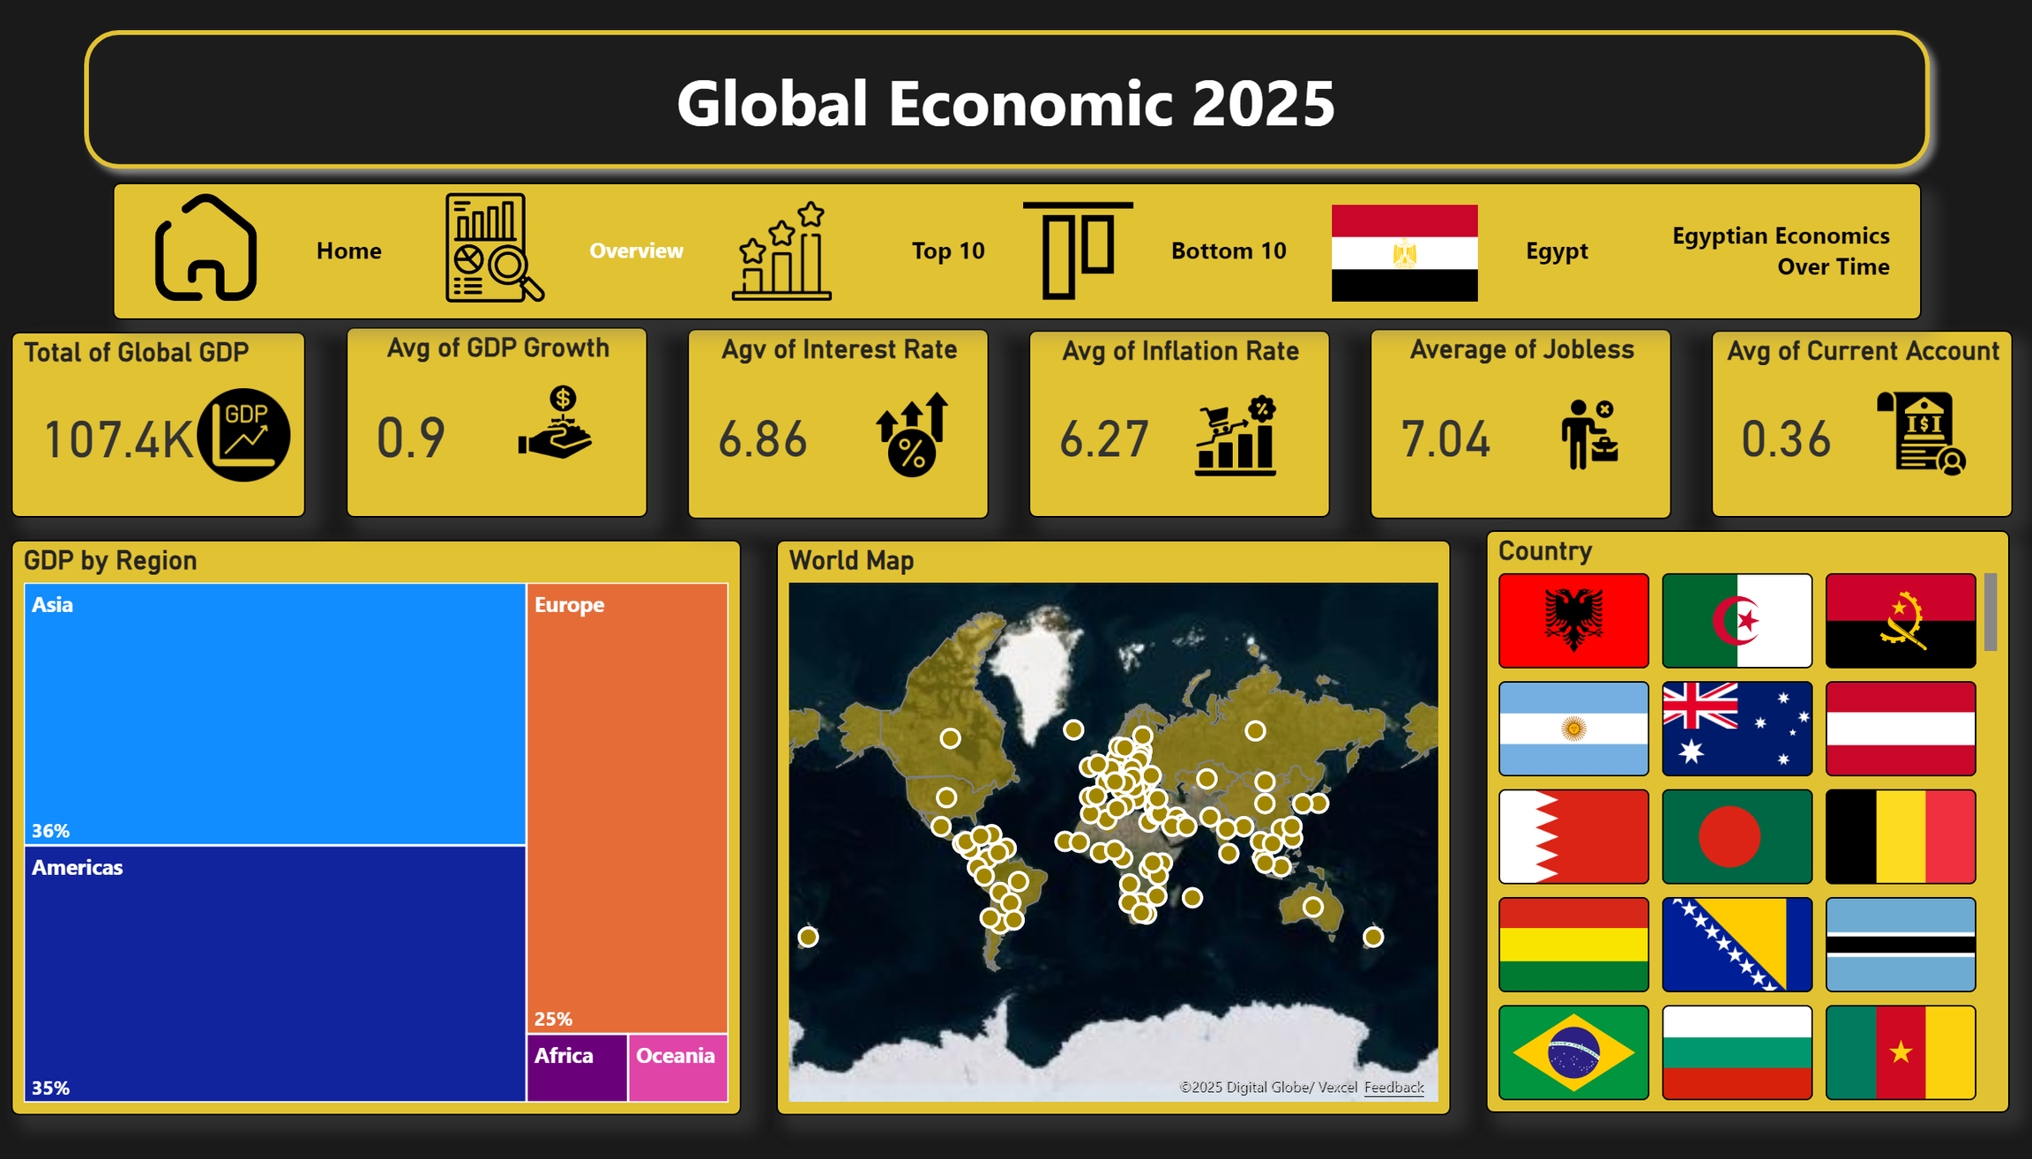
Notes:
GDP by Region
No alt text provided
World Map
No alt text provided
Country
No alt text provided
image
No alt text provided
image
No alt text provided
Total of Global GDP
No alt text provided
Avg of GDP Growth
No alt text provided
image
No alt text provided
Agv of Interest Rate
No alt text provided
image
No alt text provided
Avg of Inflation Rate
No alt text provided
image
No alt text provided
Average of Jobless
No alt text provided
image
No alt text provided
Avg of Current Account
No alt text provided
shape
No alt text provided
image
No alt text provided
image
No alt text provided
image
No alt text provided
image
No alt text provided
image
No alt text provided
pageNavigator
No alt text provided

Slide 5
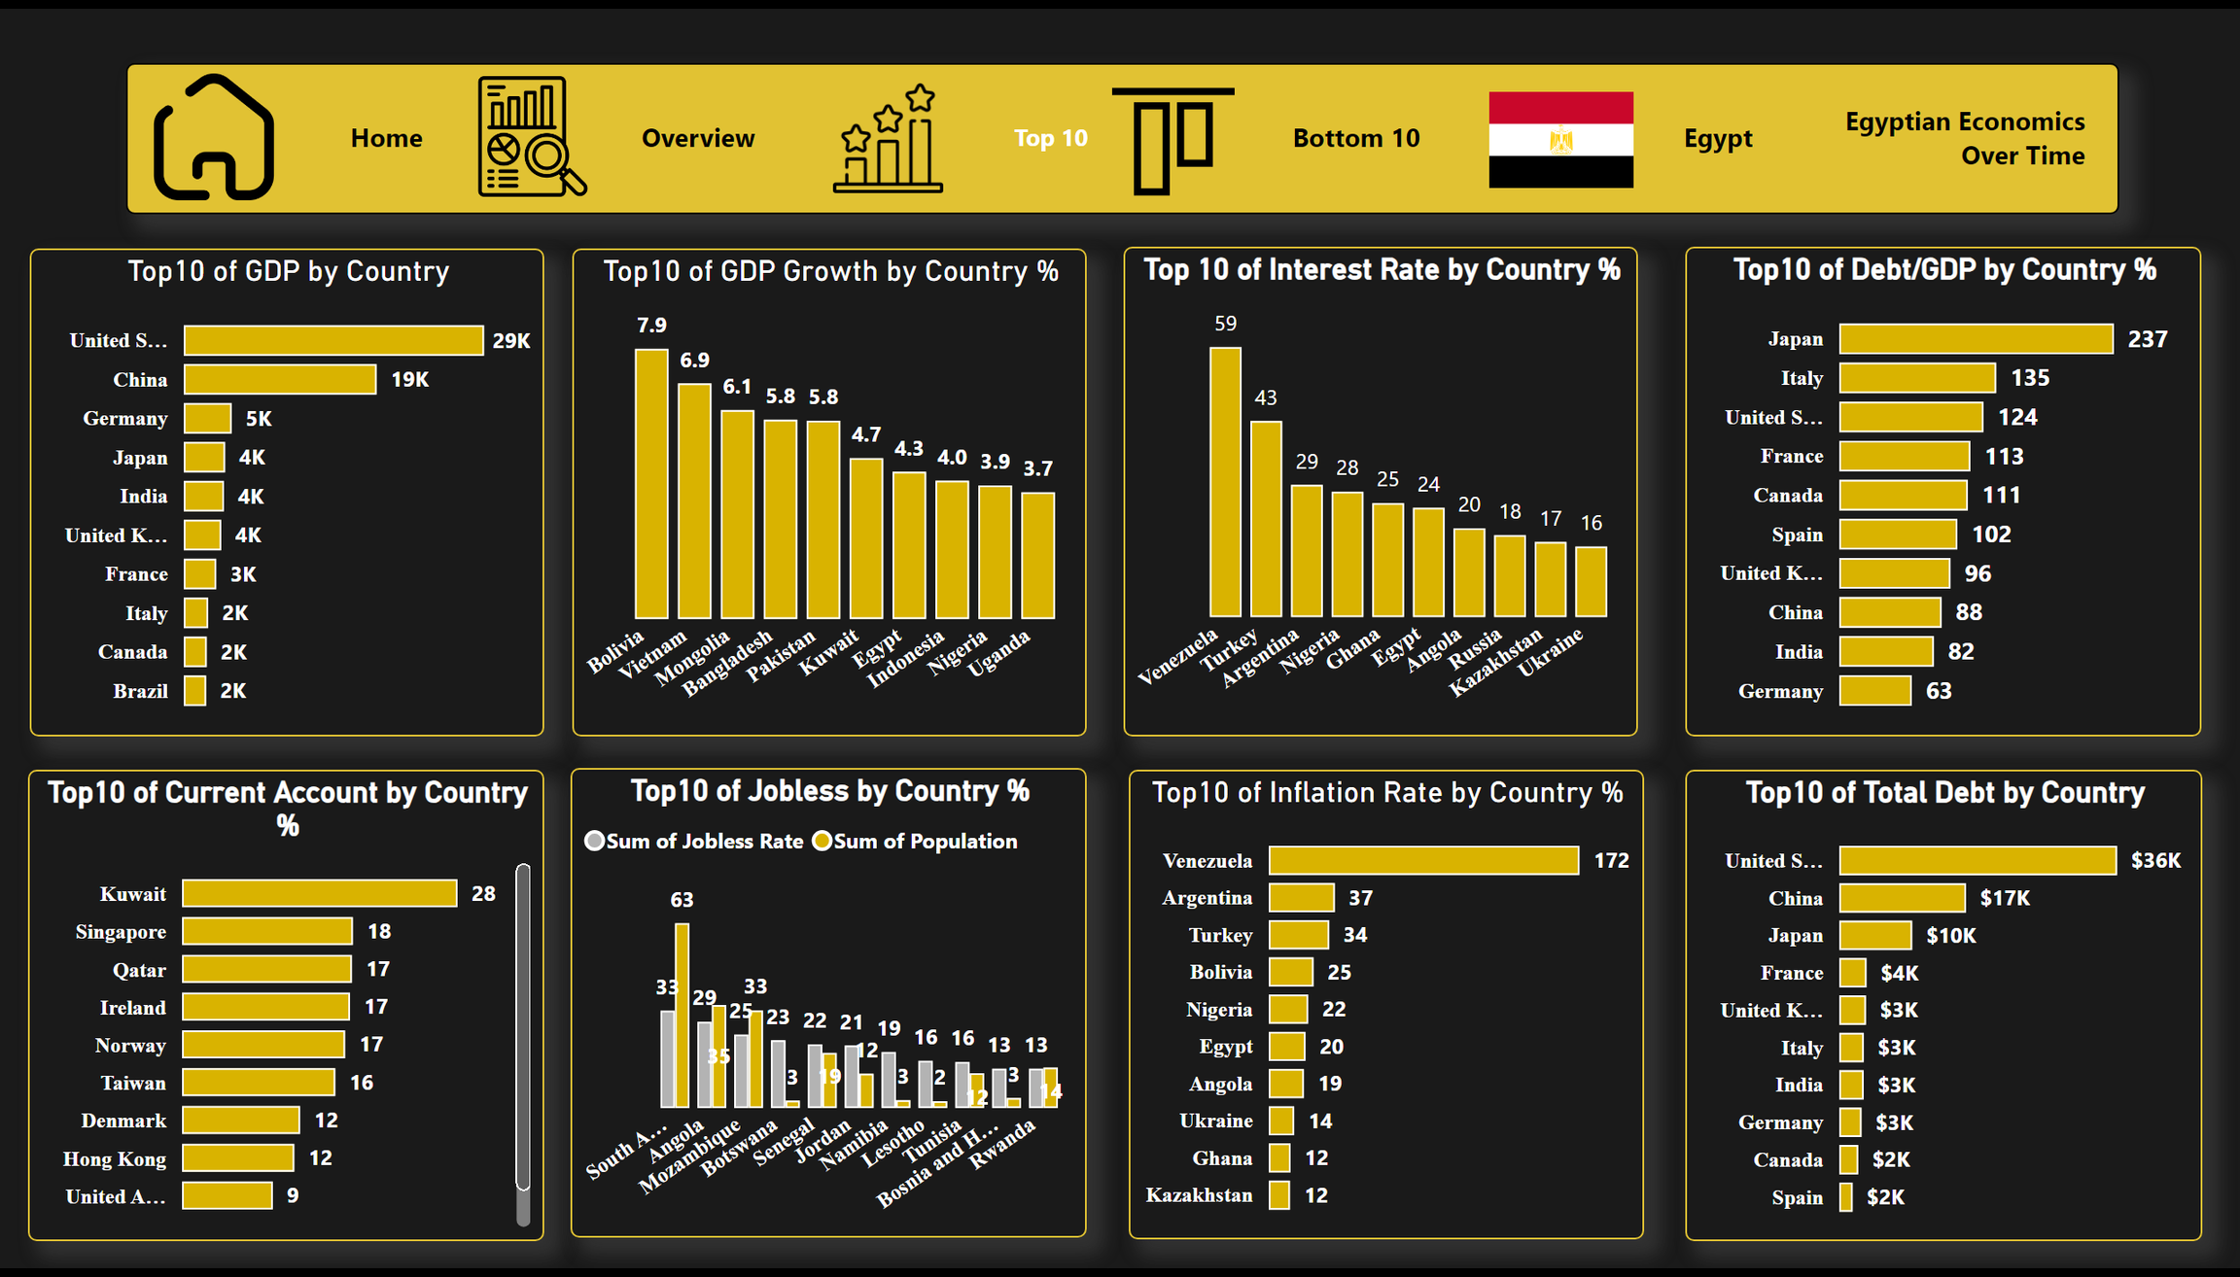
Notes:
Top10 of GDP Growth by Country %
No alt text provided
Top10 of GDP by Country
No alt text provided
Top 10 of Interest Rate by Country %
No alt text provided
Top10 of Debt/GDP by Country %
No alt text provided
Top10 of Total Debt by Country
No alt text provided
Top10 of Inflation Rate by Country %
No alt text provided
Top10 of Jobless by Country %
No alt text provided
Top10 of Current Account by Country %
No alt text provided
image
No alt text provided
image
No alt text provided
image
No alt text provided
image
No alt text provided
image
No alt text provided
pageNavigator
No alt text provided

Slide 6

TOP 10 Countries
Top 10 GDP
USA (29K), China (19K), Germany, Japan, India
Top GDP Growth
Bolivia, Vietnam, Mongolia
Top Interest Rates
Venezuela (59), Turkey (43), Argentina (29)
Highest Debt/GDP
Japan (237%), Italy (135%), USA (124%)

Slide 7
TOP 10 Countries
Highest Unemployment
South Africa, Angola, Mozambique
Strongest Current Account
Kuwait, Singapore, Qatar
Highest Inflation
Venezuela (172), Argentina (37), Turkey (34)
Total Debt Leaders
USA ($36K), China ($17K), Japan ($10K)

Slide 8
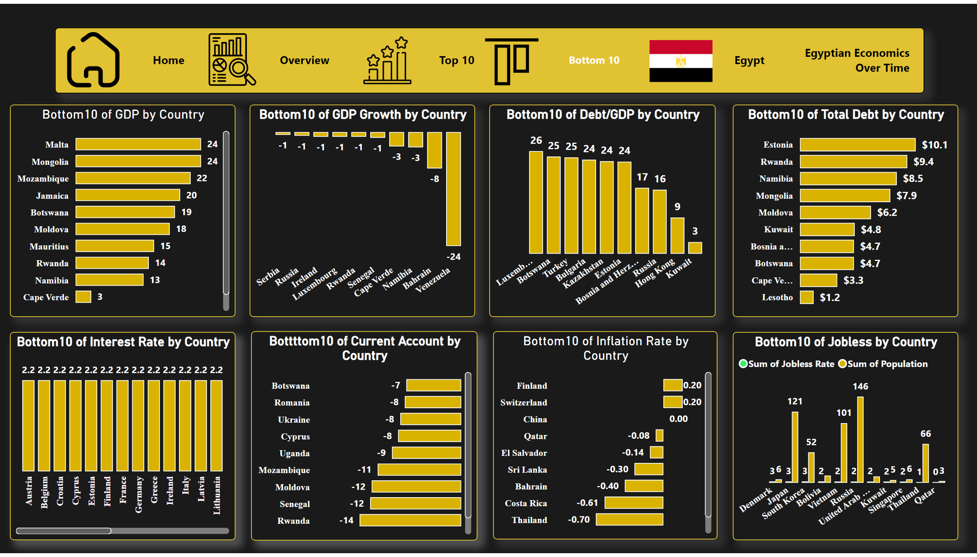
Notes:
Bottom10 of Jobless by Country
No alt text provided
Bottom10 of Total Debt by Country
No alt text provided
Bottom10 of Debt/GDP by Country
No alt text provided
Bottom10 of GDP Growth by Country
No alt text provided
Bottom10 of GDP by Country
No alt text provided
Bottom10 of Interest Rate by Country
No alt text provided
Bottttom10 of Current Account by Country
No alt text provided
Bottom10 of Inflation Rate by Country
No alt text provided
image
No alt text provided
image
No alt text provided
image
No alt text provided
image
No alt text provided
image
No alt text provided
pageNavigator
No alt text provided

Slide 9

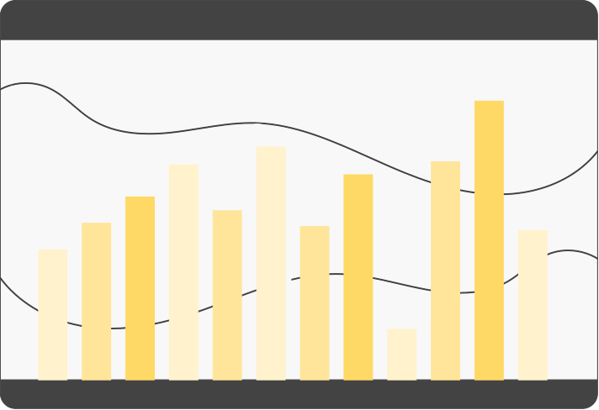


bottom 10
Lowest GDP
Malta, Mongolia, Mozambique, Jamaica
Negative GDP Growth
Venezuela (-24), Bahrain, Namibia
Lowest Debt/GDP
Luxembourg, Botswana, Turkey, Bulgaria
Lowest Total Debt
Estonia ($10.1), Rwanda, Namibia

Slide 10
bottom 10
Lowest Interest Rates
Austria, Belgium, Cyprus (2.2%)
Weakest Current Account
Rwanda (-14), Senegal, Moldova
Lowest Inflation
Thailand (-0.70), Costa Rica, Bahrain
Lowest Unemployment:
Denmark, Japan, South Koreaamibia

Slide 11

Global Country-Level Performance
The data confirm that the United States and China remain the world’s dominant economies. Strong growth was observed in several emerging markets, whereas the highest inflation levels were concentrated in countries experiencing economic instability or fiscal imbalances.
Countries ranking at the bottom of global economic indicators exhibited:
• Weak or negative growth
• High public debt levels
• Moderate to high unemployment
• Mixed inflation trends
This reflects ongoing structural challenges and limited fiscal space in many developing nations.

Slide 13



Egypt’s Economic Snapshot 2025 Subtitle: Growth, Inflation, Debt, and Employment Presenter
Overview of Egypt's key economic indicators in 2025, including growth, inflation, government debt, budget, and employment.
Highlight how these numbers are interconnected and their implications for everyday life.

Slide 14
Growth and Jobs Content
GDP Growth: 4.3%
Real GDP: 389 (billion EGP/USD)
Unemployment Rate: 6.1% (down from 6.5%)
Economic growth in 2025 created more jobs. Key sectors driving growth include manufacturing, tourism, and IT. This reduced unemployment while encouraging investment.

Slide 15


Inflation and Interest Rate
Inflation Rate: 20.4% (example: 100 EGP buys 3 items instead of 5)
Interest Rate: 24%
Script: “High inflation reduced purchasing power. The Central Bank set interest rates high to reduce spending, encourage saving, and stabilize the economy.”

Slide 16



Government Budget & Debt
Budget Deficit: -7% of GDP
Debt/GDP: 82%
The government spent more than it collected, leading to a budget deficit of -7% of GDP. High debt limits the government’s ability to invest and affects interest payments.

Slide 17

Current Account
Current Account Balance: -5.7
The negative current account means imports exceed exports, putting pressure on foreign currency and contributing to inflation. It is linked to government spending and debt levels.

Slide 18
Egypt in Africa – Key Economic Indicators
Egypt is the second largest economy in Africa after South Africa, showing its significant size compared to other African countries.
Egypt shows the highest GDP growth among these African countries, indicating rapid economic expansion compared to others, including South Africa.

Slide 19
Egypt in Africa – Key Economic Indicators
Egypt ranks third in interest rates, reflecting tight monetary policy to control inflation and stabilize the currency.
Egypt has the second highest inflation in Africa. High inflation impacts purchasing power despite strong GDP growth.

Slide 20
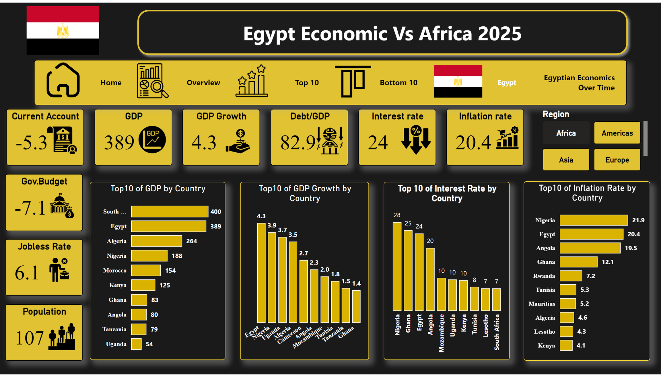
Egypt
Notes:
Region
No alt text provided
shape
No alt text provided
image
No alt text provided
Top10 of GDP by Country
No alt text provided
Top10 of GDP Growth by Country
No alt text provided
Top 10 of Interest Rate by Country
No alt text provided
Top10 of Inflation Rate by Country
No alt text provided
image
No alt text provided
Population
No alt text provided
image
No alt text provided
Jobless Rate
No alt text provided
image
No alt text provided
Gov.Budget
No alt text provided
image
No alt text provided
Current Account
No alt text provided
image
No alt text provided
GDP
No alt text provided
image
No alt text provided
image
No alt text provided
Debt/GDP
No alt text provided
image
No alt text provided
Interest rate
No alt text provided
image
No alt text provided
Inflation rate
No alt text provided
GDP Growth
No alt text provided
image
No alt text provided
image
No alt text provided
image
No alt text provided
image
No alt text provided
image
No alt text provided
pageNavigator
No alt text provided

Slide 21
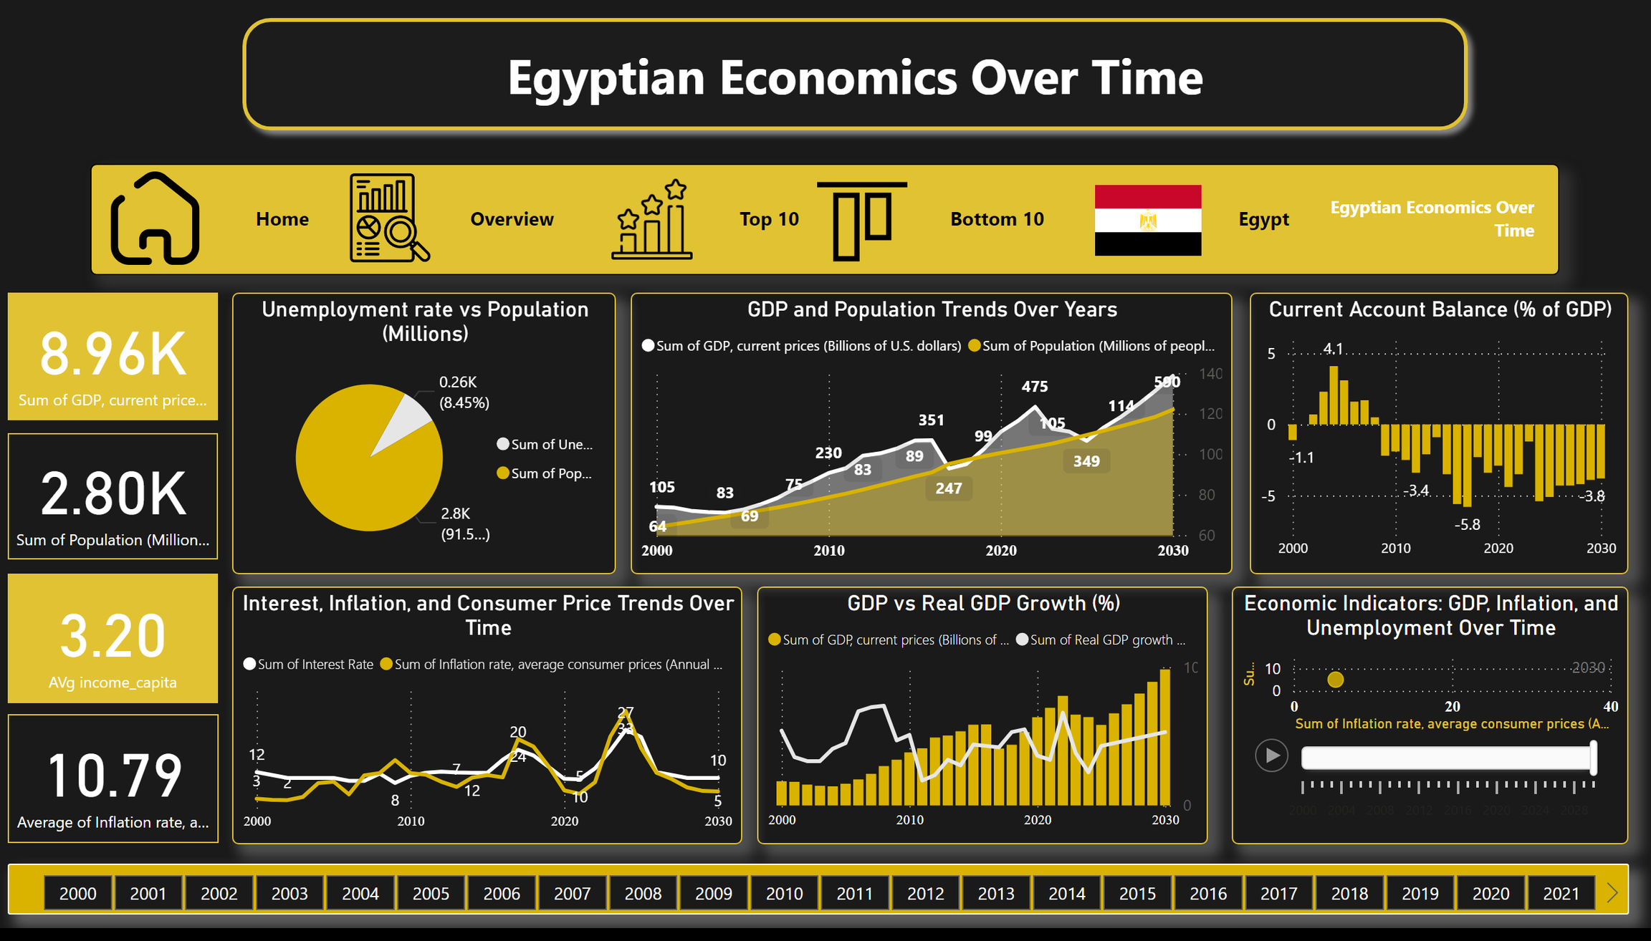
Egyptian Economics Over Time
Notes:
Unemployment rate vs Population (Millions)
No alt text provided
GDP and Population Trends Over Years
No alt text provided
Current Account Balance (% of GDP)
No alt text provided
Economic Indicators: GDP, Inflation, and Unemployment Over Time
No alt text provided
GDP vs Real GDP Growth (%)
No alt text provided
image
No alt text provided
image
No alt text provided
image
No alt text provided
image
No alt text provided
image
No alt text provided
pageNavigator
No alt text provided
shape
No alt text provided
card
No alt text provided
slicer
No alt text provided
card
No alt text provided
card
No alt text provided
card
No alt text provided
Interest, Inflation, and Consumer Price Trends Over Time
No alt text provided

Slide 22

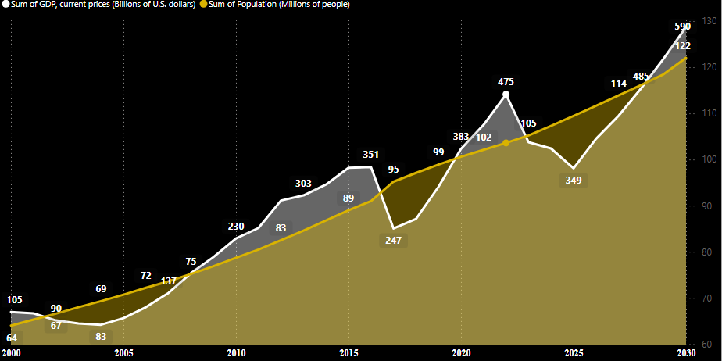
GDP& Population
1. Population Growth Rate:
Egypt’s population grows steadily at about 1.3%–1.4% per year.
2. GDP Growth Rate:
On average, Egypt’s GDP grows around 4%–5% per year, which is clearly higher than population growth.
3. Years When GDP Declined:
GDP dropped in 2015→2016, again in 2019→2020, and once more in 2022→2023.
4. Years When GDP Increased:
Most other years show solid GDP growth, especially 2016–2019, 2021–2022, and expected growth again in 2024–2025.
5. Balance Between Both:
Because GDP growth (4–5%) is higher than population growth (1.3–1.4%), there is a positive balance, meaning GDP per capita should improve—except in the years when GDP dropped

Slide 23
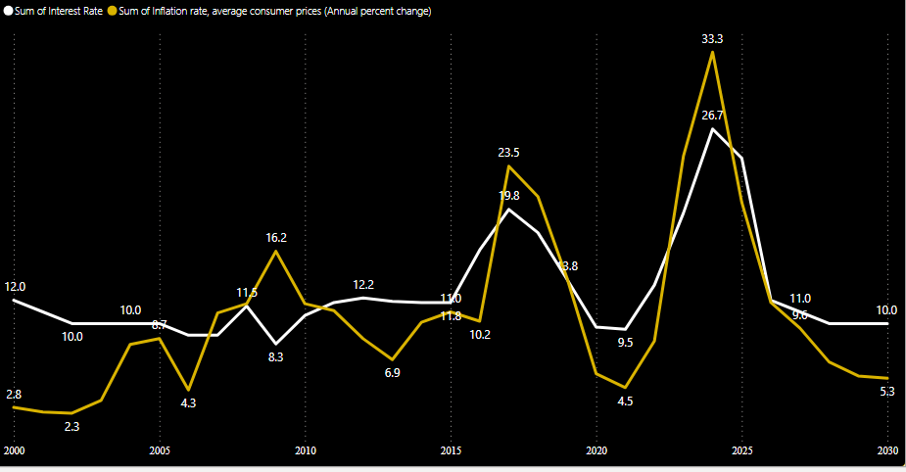

interest rate & inflation rate
* Extreme Inflation: The inflation rate (Yellow) was highly volatile, reaching a peak of 33.3% in 2024 and a high of 23.5% in 2017.
* General Co-Movement: Both the Interest Rate (White) and Inflation Rate (Yellow) generally move up and down together across the 30-year span.
* Negative Real Rate: Inflation significantly exceeded the Interest Rate in key years (e.g., 2008-2009 and 2024), resulting in negative returns for savers.
* Monetary Tightening: The Interest Rate surpassed Inflation in 2010 and is projected to do so again in 2025, indicating Central Bank efforts to curb prices.
* 2030 Stability: Both rates are forecasted to drop sharply toward 2030, with Interest Rate at 10.0% and Inflation at 5.3%, suggesting future stabilityt

Slide 24
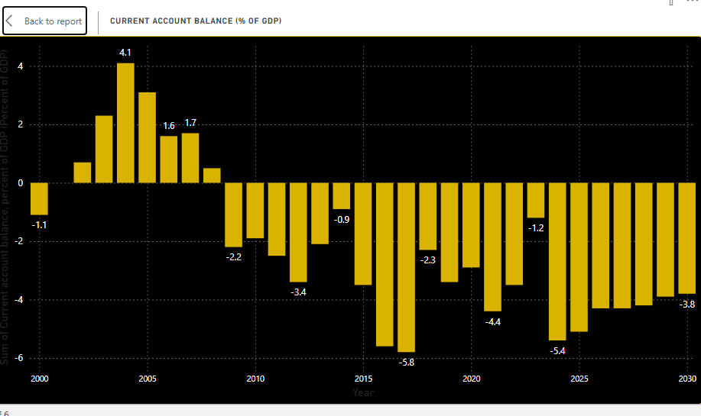

Slide 25
CURRENT ACCOUNT BALANCE
* Period of Surplus (2002–2008):
Egypt maintained a positive current account balance for seven consecutive years, peaking at 4.1% of GDP in 2004. This means the country was a net lender to the world during this time.
* Shift to Deficit (Post-2009):
The balance shifted into a persistent deficit starting in 2009 and is projected to remain negative until at least 2030. This indicates continuous reliance on external financing.
* Years of Deepest Deficit:
The most severe deficits occurred in 2016 (reaching -5.8% of GDP) and recently in 2024 (at -5.4%). These spikes reflect significant trade imbalances or external pressures.
* Trend of Improvement (Post-2016):
Following the 2016 low, the deficit showed a modest trend of improvement (becoming less negative) until 2018, stabilizing around the -2% to -4% range from 2019 to 2023
* Current Outlook and Projection:
After the 2024 dip (-5.4%), the current account deficit is projected to narrow significantly towards 2030, expected to reach -3.8% of GDP. This suggests a gradual recovery in the external sector balance.

Slide 26
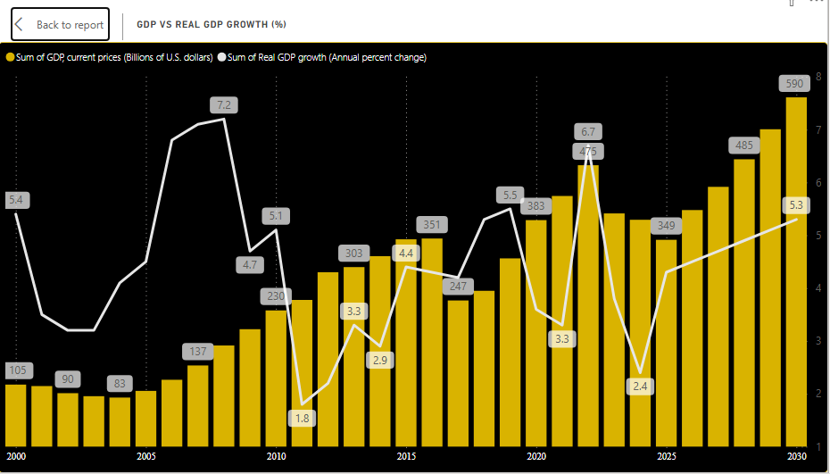

Slide 27
GDP VS. REAL GDP GROWTH
* Consistent Nominal Growth:
GDP at Current Prices (Bars) shows a nearly uninterrupted upward trend from $83 Billion (2002) to a projected $590 Billion (2030), indicating massive growth in nominal terms.
* Volatile Real Growth:
Real GDP Growth (White line) is highly volatile. It peaked at 7.2% (2007) and sharply dropped to lows of 1.8% (2011) and 2.4% (2023).
* Years of Strong Growth (2006–2008):
This period saw a combination of high nominal GDP (rising sharply) and peak Real GDP growth (above 6% annually), representing a time of significant economic expansion.
* Major Decoupling (Post-2010):
After 2010, the Real GDP Growth rate remained generally lower than its pre-2010 highs, despite the Nominal GDP continuing its rapid climb. The gap suggests that a significant portion of the nominal increase is driven by inflation (as nominal GDP includes price changes).
* Future Outlook (2025–2030):
Both indicators are projected to show solid performance. Nominal GDP will rise rapidly toward $590 Billion, supported by a projected healthy and stabilizing Real GDP growth rate, leveling off at around 5.3% by 2030.

Slide 28
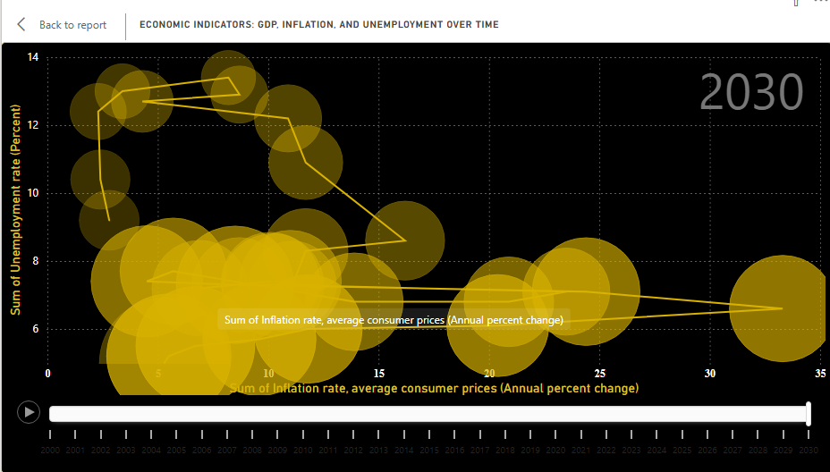
Inflation, Unemployment & GDP
* Highest Unemployment Rate:
The highest recorded unemployment rate in the data series was 13.40% in 2004. This period was associated with a relatively low inflation rate of 8.20%, aligning with the traditional Phillips Curve inverse relationship.
* Lowest Unemployment Rate (Projected):
The unemployment rate is projected to fall to its lowest point, reaching 5.20% by 2029. This low unemployment is expected to coincide with a projected inflation rate of 5.50% and a very high nominal GDP of $535.99 Billion.
* Inflation Peak and GDP (2024):
The data shows a massive inflation spike, peaking at 33.30% in 2024. This extreme high occurred alongside a relatively low unemployment rate of 6.60% and a nominal GDP of $383.11 Billion.
* Highest Nominal GDP (Projected):
The nominal GDP reaches its peak value (largest bubble) towards the end of the projection, hitting $535.99 Billion in 2029. This high GDP is associated with both a low unemployment rate (5.20%) and a moderate inflation rate (5.50%).
* General Trajectory and Trade-off:
The overall path on the chart shows a long-term movement from the top-left corner (High Unemployment, Low Inflation) toward the bottom-right corner (Low Unemployment, High/Moderate Inflation), especially during the 2004–2010 period. However, the 2024 inflation spike (33.30%) represents a significant outlier, breaking the general trade-off tren

Slide 29
RECOMENDATION
* Positive Real Rates: Maintain interest rates above inflation to stabilize the currency and encourage savings.
* Export Focus: Aggressively boost exports and attract foreign direct investment (FDI) to fix the chronic trade deficit.
* Empower Private Sector: Accelerate structural reforms to remove obstacles and make the private sector the main driver of economic growth.
* Invest in Skills: Prioritize vocational training and education to ensure the low unemployment rate is productive and sustainable.
* Debt Management: Implement strict fiscal discipline to reduce government debt and limit reliance on heavy borrowing

